Slide 1



Sales Analysis
MERI SKILL INTERNSHIP
SECOND Project
ENG. Khalid Saif
EMAIL. khalidm7422@gmail.com

Slide 2

OVERVIEW
COM Inc. is a company that sells a wide range of electronic gadgets, including smartphones, laptops, and accessories. The company operates in several regions and has multiple sales channels, including online and retail stores. Recently, the management has noticed fluctuations in sales performance across different regions and product categories. They have tasked the data analysis team with analyzing sales data to uncover trends, identify high-performing products, and pinpoint areas for improvement.

Slide 3
Data Collection The sales data includes the following variables:
Date: The date of the sale.
CITY: The geographical city where the sale was made.
Product: the product sold
Address: the location of the customers
(e.g., smartphones, laptops, accessories).
Product ID: A unique identifier for each product.
QTY: The number of units sold.
Unit Price: The price per unit of the product.
Hour: the Hour of Purchase.
Total Revenue: The total revenue generated from the sale
(Units Sold * Unit Price).

Slide 4
ANALYSIS
Analysis:
Descriptive Statistics:
Calculate total sales revenue and sales QTY.
Determine the distribution of sales across different regions.
Identify the top-selling products.
Trend Analysis:
Analyze sales trends over time (e.g., monthly or daily) to identify seasonal patterns.
Compare products sales performance with the historical data.
Regional Performance:
Evaluate sales performance across different regions to identify high-performing and underperforming areas.
Assess regional differences in product preferences.

Slide 5



TRANSFORM
EXTRACT
LOAD
DATA SCOURCE
SSMS
EXCEL
6/30/2024
5

Slide 6
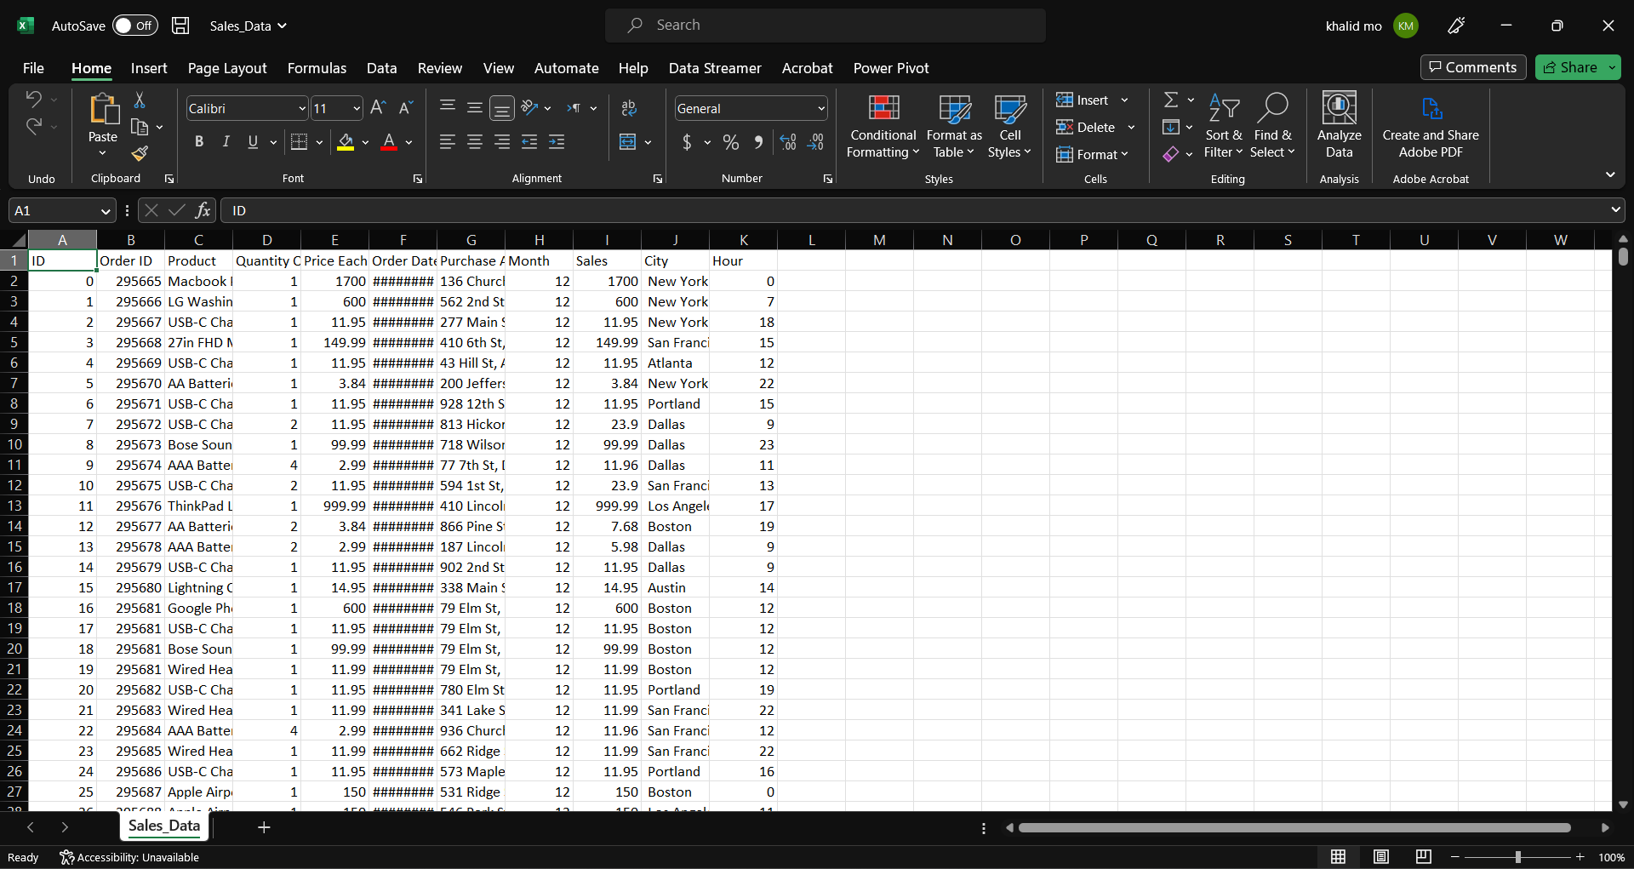
DATA SOURCE (CSV) FILE

Slide 7
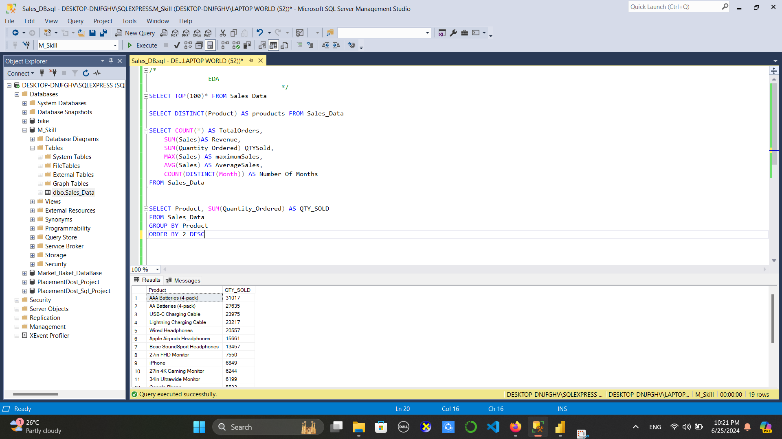
Extract

Slide 8
Transform

Slide 9
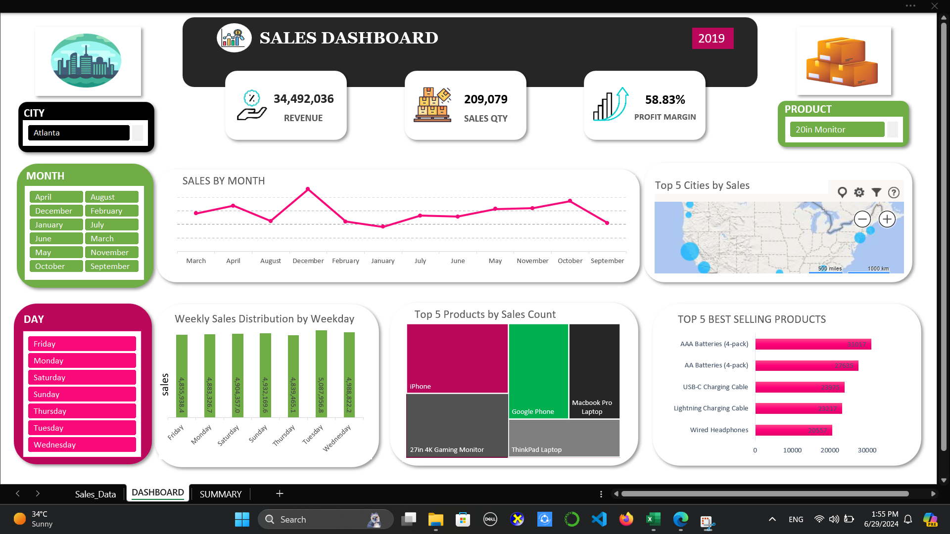
LOAD

Slide 10
Data visualization

